Slide 1
Lexical Analysis (Scanning)
Week 2
Amna Irum

Slide 2
Overview
tokens
source
program
lexical analyzer
(scanner)
syntax analyzer
(parser)
symbol table
manager
Main task: to read input characters and group them into “tokens.”
Secondary tasks:
  Skip comments and whitespace;
  Correlate error messages with source program (e.g., line number of error).

Slide 3
Overview (cont’d)
Token
sequence
Input file
keywd_int
identifier: “main”
left_paren
keywod_int
identifier: “argc”
comma
keywd_char
star
star
identifier: “argv”
right_paren
left_brace
keywd_int
…
/ | * | p | g | m | . | c | * | / | \n | i | n
t |  | m | a | i | n | ( | i | n | t |  | a
r | g | c | , | c | h | a | r | * | * | a | r
g | v | ) | { | \n | \t | i | n | t |  | x | ,
Y | ; | \n | \t | f | l | o | a | t |  | w | ;
lexical
analyzer
. . .

Slide 4
Implementing Lexical Analyzers
Different approaches:
  Using a scanner generator, e.g., lex or flex. This automatically generates a lexical analyzer from a high-level description of the tokens.
  (easiest to implement; least efficient)
  Programming it in a language such as C, using the I/O facilities of the language.
  (intermediate in ease, efficiency)
  Writing it in assembly language and explicitly managing the input.
  (hardest to implement, but most efficient)

Slide 5
Lexical Analysis: Terminology
token: a name for a set of input strings with related structure.
Example: “identifier,” “integer constant”
pattern: a rule describing the set of strings associated with a token.
Example: “a letter followed by zero or more letters, digits, or underscores.”
lexeme: the actual input string that matches a pattern.
Example: count

Slide 6
Examples
Input: count = 123
Tokens:
  identifier : Rule: “letter followed by …”
    Lexeme: count
  assg_op : Rule: =
  Lexeme: =
  integer_const : Rule: “digit followed by …”
  Lexeme: 123

Slide 7
Attributes for Tokens
If more than one lexeme can match the pattern for a token, the scanner must indicate the actual lexeme that matched.
This information is given using an attribute associated with the token.
  Example: The program statement
    count = 123
  yields the following token-attribute pairs:
    ⟨identifier, pointer to the string “count”⟩
    ⟨assg_op, ⟩
    ⟨integer_const, the integer value 123⟩

Slide 8
Issues in Lexical Analysis
There are several reasons for separating the analysis phase of compiling into lexical analysis and parsing:
  Simpler design
  Compiler efficiency
  Compiler portability
Specialized tools have been designed to help automate the construction of lexical analyzer and parser when they are separated.

Slide 9
Lexeme and Token
Index = 2 * count +17;
Lexemes
Tokens
Index
Identifier
=
equal_sign
2
int_literal
*
multi_op
Count
identifier
+
plus_op
17
int_literal
;
semicolon

Slide 10
Lexical Errors
Few errors are discernible at the lexical level alone, because a lexical analyzer has a very localized view of a source program.
Let some other phase of compiler handle any error.
Panic mode
Error recovery

Slide 11
Adhoc Lexer
The task of writing a scanner is fairly straight forward.
We can hand-write code to generate tokens. We do this by partitioning the input string by reading left-to- right, recognizing one token at a time.
We will need to look-ahead in order to decide where one token ends and the next token begins..

Slide 12
class Lexer
{
Inputstream s;
char next; //look ahead
Lexer(Inputstream _s)
{
s = _s;
next = s.read(); }
Token nextToken() {
if( idChar(next) )return readId(); if( number(next)
)
return readNumber(); if( next == ‘”’ ) return readString();
...
...
}
Token readId() { string id = “”; while(true){
char c = input.read(); if(idChar(c) == false)
return new Token(TID,id); id = id
+ string(c);
}
}
boolean idChar(char c)
{
if( isAlpha(c) ) return true; if( isDigit(c)
) return true; if( c == ‘_’ ) return true;
return false;
}
Token readNumber(){ string num = “”; while(true){
next = input.read(); if(
!isNumber(next))
return new Token(TNUM,num); num
= num+string(next);
}
}

Slide 13
There are some problem that we need to tackle.
We do not know what kind of token we are going to read from seeing first character.
If token begins with “i”, is it an identifier “i” or keyword “if”?
If token begins with “=”, is it “=” or “==”?
We can extend the Lexer class but there are a number of other issues that can make the task of hand-writing a lexer tedious. We need a more principled approach. The most frequently used approach is to use a lexer generator that generates efficient tokenizer automatically.

Slide 14
Specifying Tokens: regular expressions
Terminology:
  alphabet : a finite set of symbols
  string : a finite sequence of alphabet symbols
  language : a (finite or infinite) set of strings.
Regular Operations on languages:
  Union: R ∪ S = { x | x ∈ R or x ∈ S}
  Concatenation: RS = { xy | x ∈ R and y ∈ S}
  Kleene closure: R* = R concatenated with itself 0 or more times
  = {ε} ∪ R ∪ RR ∪ RRR ∪
  = strings obtained by concatenating a finite
  number of strings from the set R.
CSc 453: Lexical Analysis

Slide 15
Regular Expressions
A pattern notation for describing certain kinds of sets over strings:
Given an alphabet Σ:
  ε is a regular exp. (denotes the language {ε})
  for each a ∈ Σ, a is a regular exp. (denotes the language {a})
  if r and s are regular exps. denoting L(r) and L(s) respectively, then so are:
    (r) | (s) ( denotes the language L(r) ∪ L(s) )
    (r)(s) ( denotes the language L(r)L(s) )
    (r)* ( denotes the language L(r)* )

Slide 16
Common Extensions to r.e. Notation
One or more repetitions of r : r+
A range of characters : [a-zA-Z], [0-9]
An optional expression: r?
Any single character: .
Giving names to regular expressions, e.g.:
  letter = [a-zA-Z_]
  digit = 0 | 1 | 2 | 3 | 4 | 5 | 6 | 7 | 8 | 9
  ident = letter ( letter | digit )*
  Integer_const = digit+

Slide 17
Finite Automata
A recognizer for a language is a program that takes as input a string x and answer “yes” if x is a sentence of the language and “no” otherwise.
We compile a regular expression into a recognizer by constructing a generalized transition diagram called a finite automaton.
A finite automaton can be deterministic or nondeterministic, where nondeterministic means that more than one transition out of a state may be possible on the same input symbol.

Slide 18
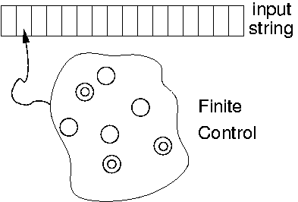
Recognizing Tokens: Finite Automata
A finite automaton is a 5-tuple (Q, Σ, T, q₀, F), where:
  Σ is a finite alphabet;
  Q is a finite set of states;
  T: Q × Σ → Q is the transition function;
  q₀ ∈ Q is the initial state; and
  F ⊆ Q is a set of final states.

Slide 19
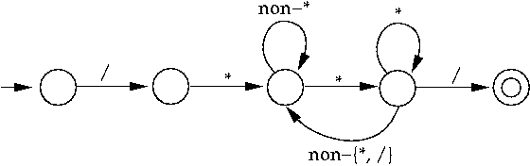
Finite Automata: An Example
A (deterministic) finite automaton (DFA) to match C-style comments:

Slide 20
Formalizing Automata Behavior
To formalize automata behavior, we extend the transition function to deal with strings:
    Ŧ : Q × Σ* → Q
    Ŧ(q, ε) = q
    Ŧ(q, aw) = Ŧ(r, w) where r = T(q, a)
The language accepted by an automaton M is
    L(M) = { w | Ŧ(q₀, w) ∈ F }.
A language L is regular if it is accepted by some finite automaton.
CSc 453: Lexical Analysis

Slide 21
Finite Automata and Lexical Analysis
The tokens of a language are specified using regular expressions.
A scanner is a big DFA, essentially the “aggregate” of the automata for the individual tokens.
Issues:
  What does the scanner automaton look like?
  How much should we match? (When do we stop?)
  What do we do when a match is found?
  Buffer management (for efficiency reasons).

Slide 22
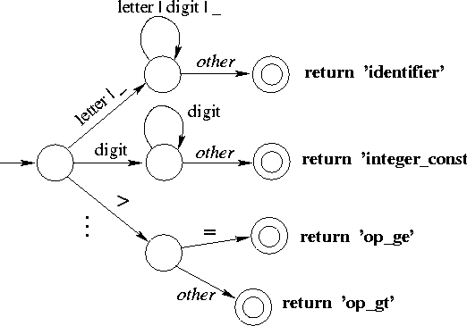
Structure of a Scanner Automaton

Slide 23
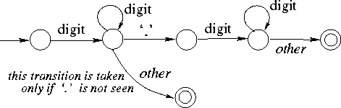
How much should we match?
In general, find the longest match possible.
E.g., on input 123.45, match this as
    num_const(123.45)
rather than
    num_const(123), “.”, num_const(45).

Slide 24
Input Buffering
Scanner performance is crucial:
  This is the only part of the compiler that examines the entire input program one character at a time.
  Disk input can be slow.
  The scanner accounts for ~25-30% of total compile time.
We need lookahead to determine when a match has been found.
Scanners use double-buffering to minimize the overheads associated with this.
CSc 453: Lexical Analysis

Slide 25
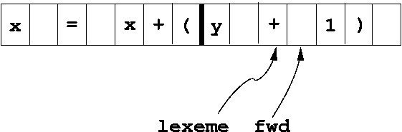
Buffer Pairs
Use two N-byte buffers (N = size of a disk block; typically, N = 1024 or 4096).
Read N bytes into one half of the buffer each time. If input has less than N bytes, put a special EOF marker in the buffer.
When one buffer has been processed, read N bytes into the other buffer (“circular buffers”).
CSc 453: Lexical Analysis

Slide 26
Buffer pairs (cont’d)
Code:
  if (fwd at end of first half)
    reload second half;
    set fwd to point to beginning of second half;
  else if (fwd at end of second half)
    reload first half;
    set fwd to point to beginning of first half;
  else
    fwd++;
  it takes two tests for each advance of the fwd pointer.
CSc 453: Lexical Analysis

Slide 27
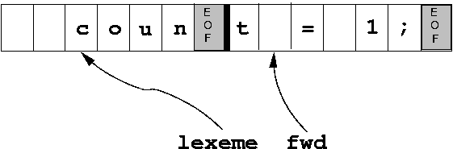
Buffer pairs: Sentinels
Objective: Optimize the common case by reducing the number of tests to one per advance of fwd.
Idea: Extend each buffer half to hold a sentinel at the end.
  This is a special character that cannot occur in a program (e.g., EOF).
  It signals the need for some special action (fill other buffer-half, or terminate processing).
CSc 453: Lexical Analysis

Slide 28
Buffer pairs with sentinels (cont’d)
Code:
  fwd++;
  if ( *fwd == EOF ) { /* special processing needed */
    if (fwd at end of first half)
      . . .
    else if (fwd at end of second half)
      . . .
    else /* end of input */
      terminate processing.
  }
  common case now needs just a single test per character.
CSc 453: Lexical Analysis

Slide 29
Handling Reserved Words
Hard-wire them directly into the scanner automaton:
  harder to modify;
  increases the size and complexity of the automaton;
  performance benefits unclear (fewer tests, but cache effects due to larger code size).
Fold them into “identifier” case, then look up a keyword table:
  simpler, smaller code;
  table lookup cost can be mitigated using perfect hashing.

Slide 30
Implementing Finite Automata 1
Encoded as program code:
  each state corresponds to a (labeled code fragment)
  state transitions represented as control transfers.
  E.g.:
    while ( TRUE ) {
    …
    state_k: ch = NextChar(); /* buffer mgt happens here */
    switch (ch) {
    case … : goto ...; /* state transition */
    …
      }
    state_m: /* final state */
    copy lexeme to where parser can get at it;
    return token_type;
    …
    }

Slide 31
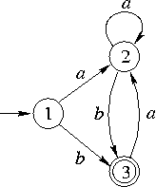
Direct-Coded Automaton: Example
int scanner()
{ char ch;
while (TRUE) {
ch = NextChar( );
state_1: switch (ch) { /* initial state */
case ‘a’ : goto state_2;
case ‘b’ : goto state_3;
default : Error();
}
state_2: …
state_3: switch (ch) {
case ‘a’ : goto state_2;
default : return SUCCESS;
}
} /* while */
}

Slide 32
Implementing Finite Automata 2
Table-driven automata (e.g., lex, flex):
  Use a table to encode transitions:
      next_state = T(curr_state, next_char);
T | next input character
Current state

Slide 33
Table-Driven Automaton: Example
#define isFinal(s) ((s) < 0)
int scanner()
{ char ch;
int currState = 1;
while (TRUE) {
ch = NextChar( );
if (ch == EOF) return 0; /* fail */
currState = T [currState, ch];
if (IsFinal(currState)) {
return 1; /* success */
}
} /* while */
}
T |  | input
 |  | a | b
state | 1 | 2 | 3
 | 2 | 2 | 3
 | 3 | 2 | -1

Slide 34
What do we do on finding a match?
A match is found when:
  The current automaton state is a final state; and
  No transition is enabled on the next input character.
Actions on finding a match:
  if appropriate, copy lexeme (or other token attribute) to where the parser can access it;
  save any necessary scanner state so that scanning can subsequently resume at the right place;
  return a value indicating the token found.

Slide 35
Nondeterministic Finite Automata (NFA)
A set of states S
A set of input symbols Σ
A transition function move that maps state-symbol pairs to sets of states
A state s₀ that is distinguished as the start (initial) state
A set of states F distinguished as accepting (final) states.

Slide 36
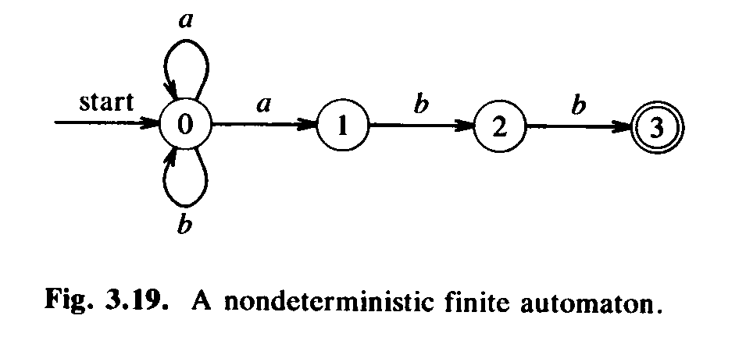
NFA
An NFA can be represented diagrammatically by a labeled directed graph, called a transition graph, in which the nodes are the states and the labeled edges represent the transition function.
(a|b)*abb
Winter 2007
SEG2101 Chapter 8

Slide 37
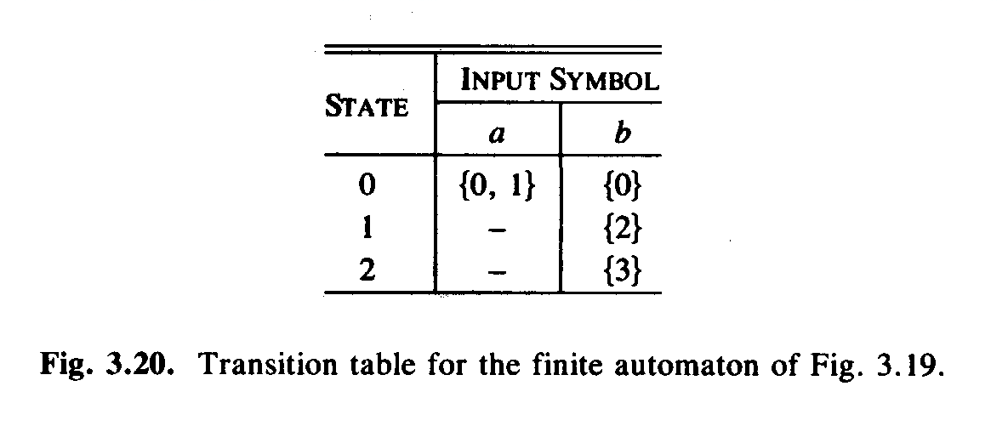
NFA Transition Table
The easiest implementation is a transition table in which there is a row for each state and a column for each input symbol and ε, if necessary.
Winter 2007
SEG2101 Chapter 8

Slide 38
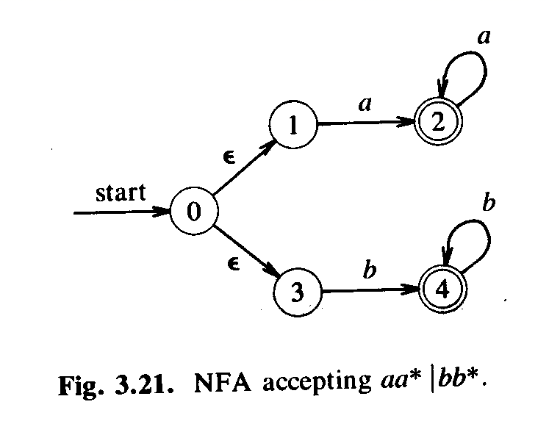
Example of NFA
SEG2101 Chapter 8

Slide 39
From Regular Expression to NFA
Thompson’s construction - an NFA from a regular expression
Input: a regular expression r over an alphabet Σ.
Output: an NFA N accepting L(r)

Slide 40
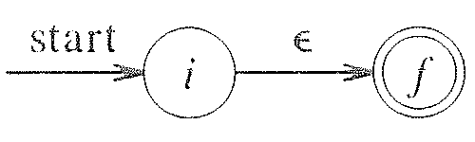
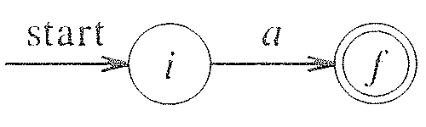
Method
First parse r into its constituent subexpressions.
Construct NFA’s for each of the basic symbols in r.
  for ε
  for a in Σ

Slide 41
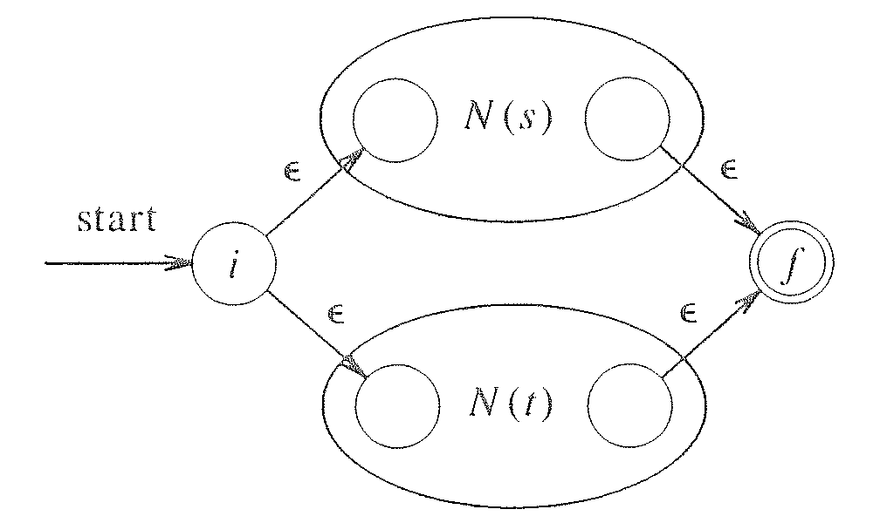
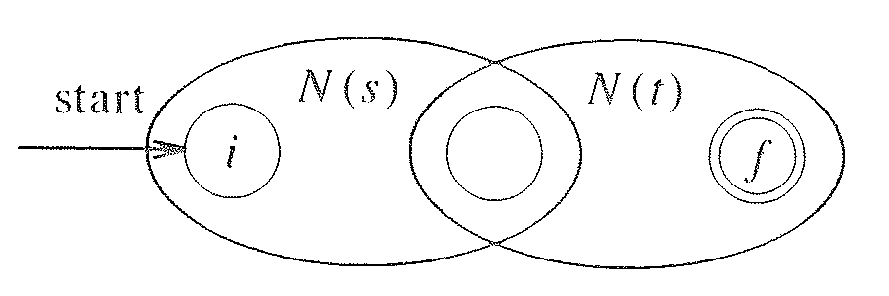
Method (II)
For the regular expression s|t,
For the regular expression st,

Slide 42
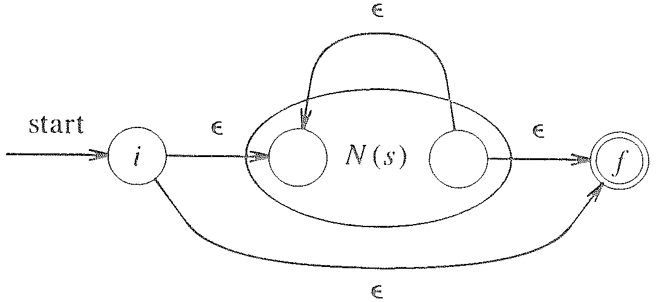
Method (III)
For the regular expression s*,
For the parenthesized regular expression (s), use N(s) itself as the NFA.
Every time we construct a new state, we give it a distinct name.

Slide 43
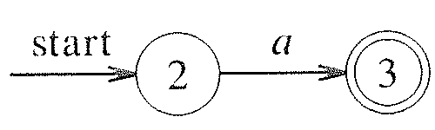
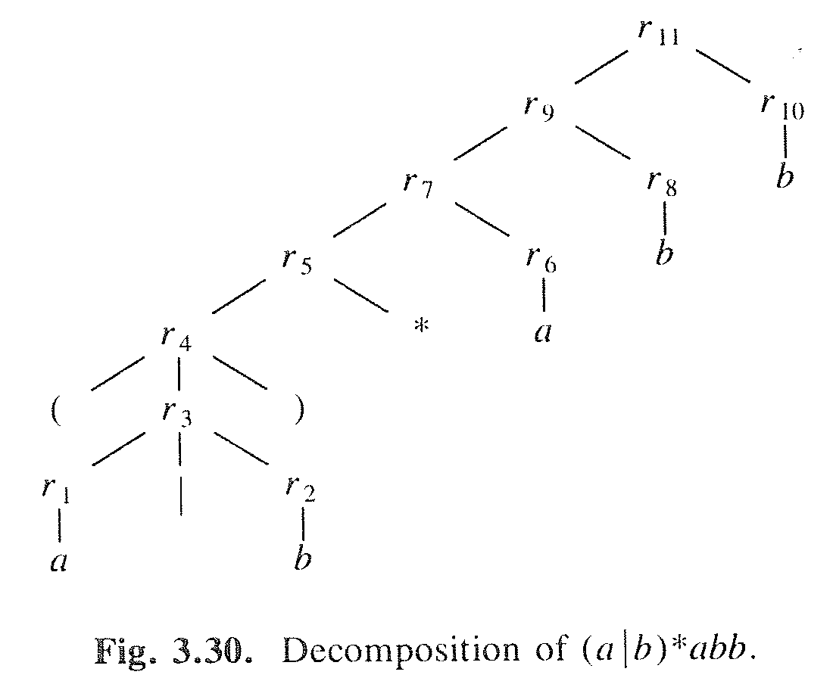
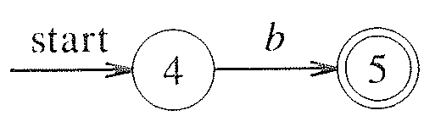
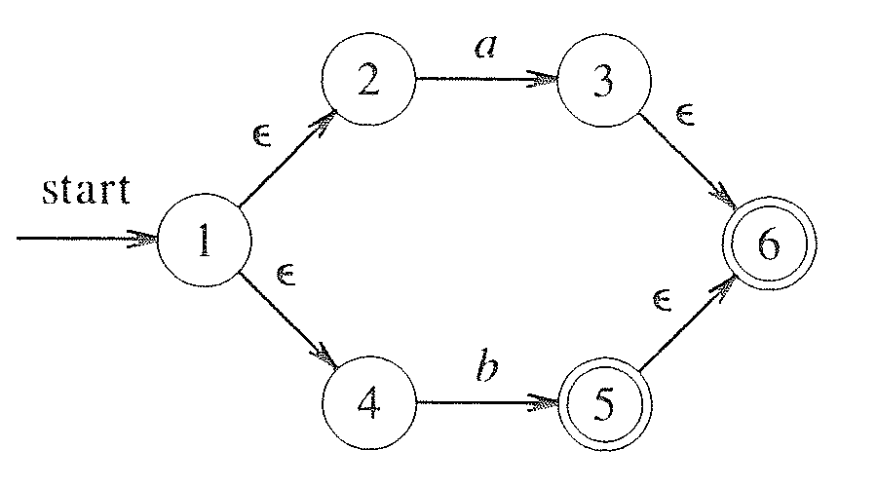
Example - construct N(r) for r=(a|b)*abb
Winter 2007
SEG2101 Chapter 8

Slide 44
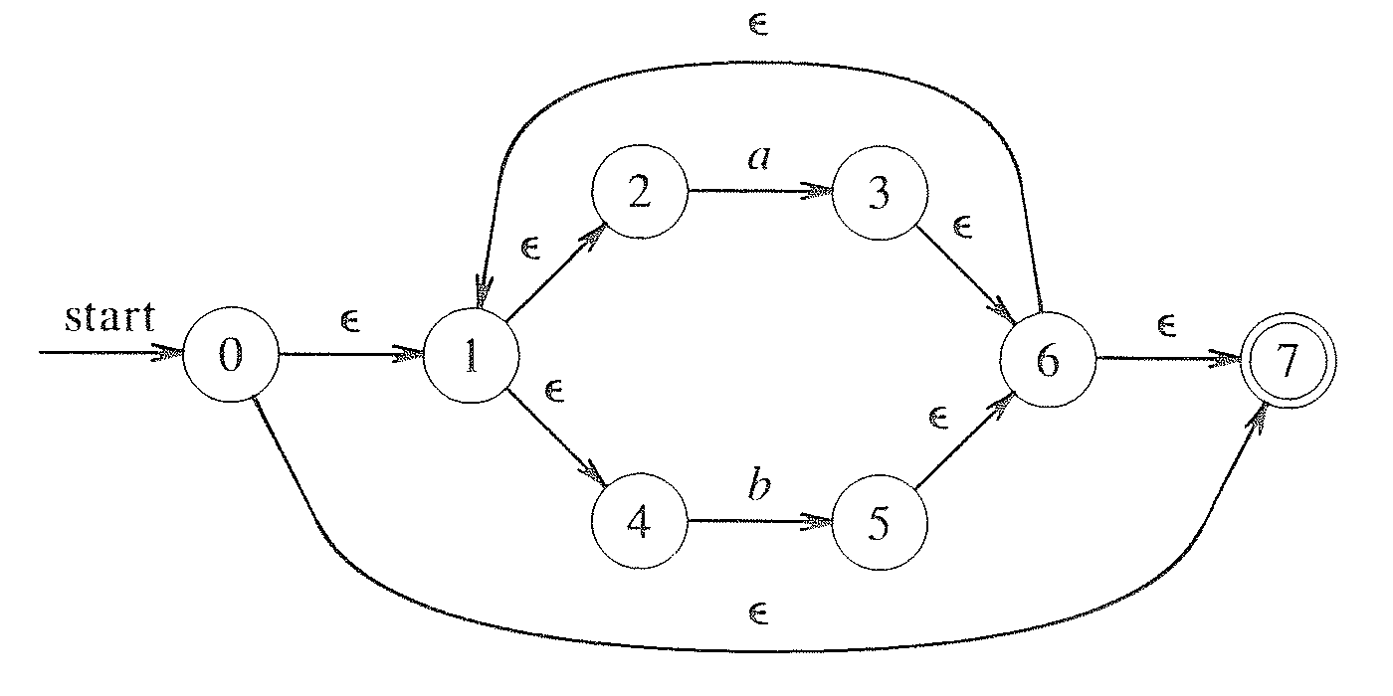
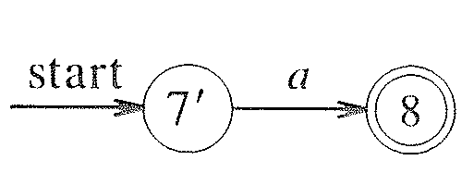
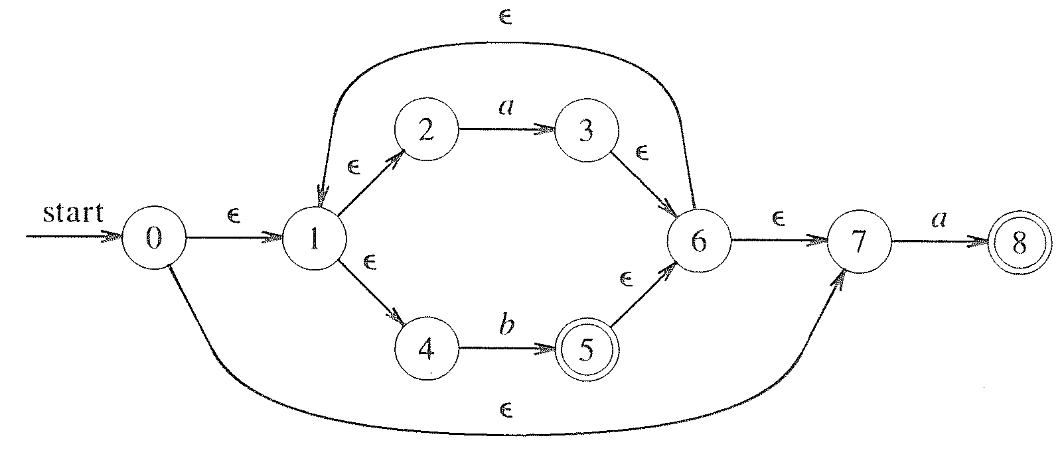
Example (II)
SEG2101 Chapter 8

Slide 45
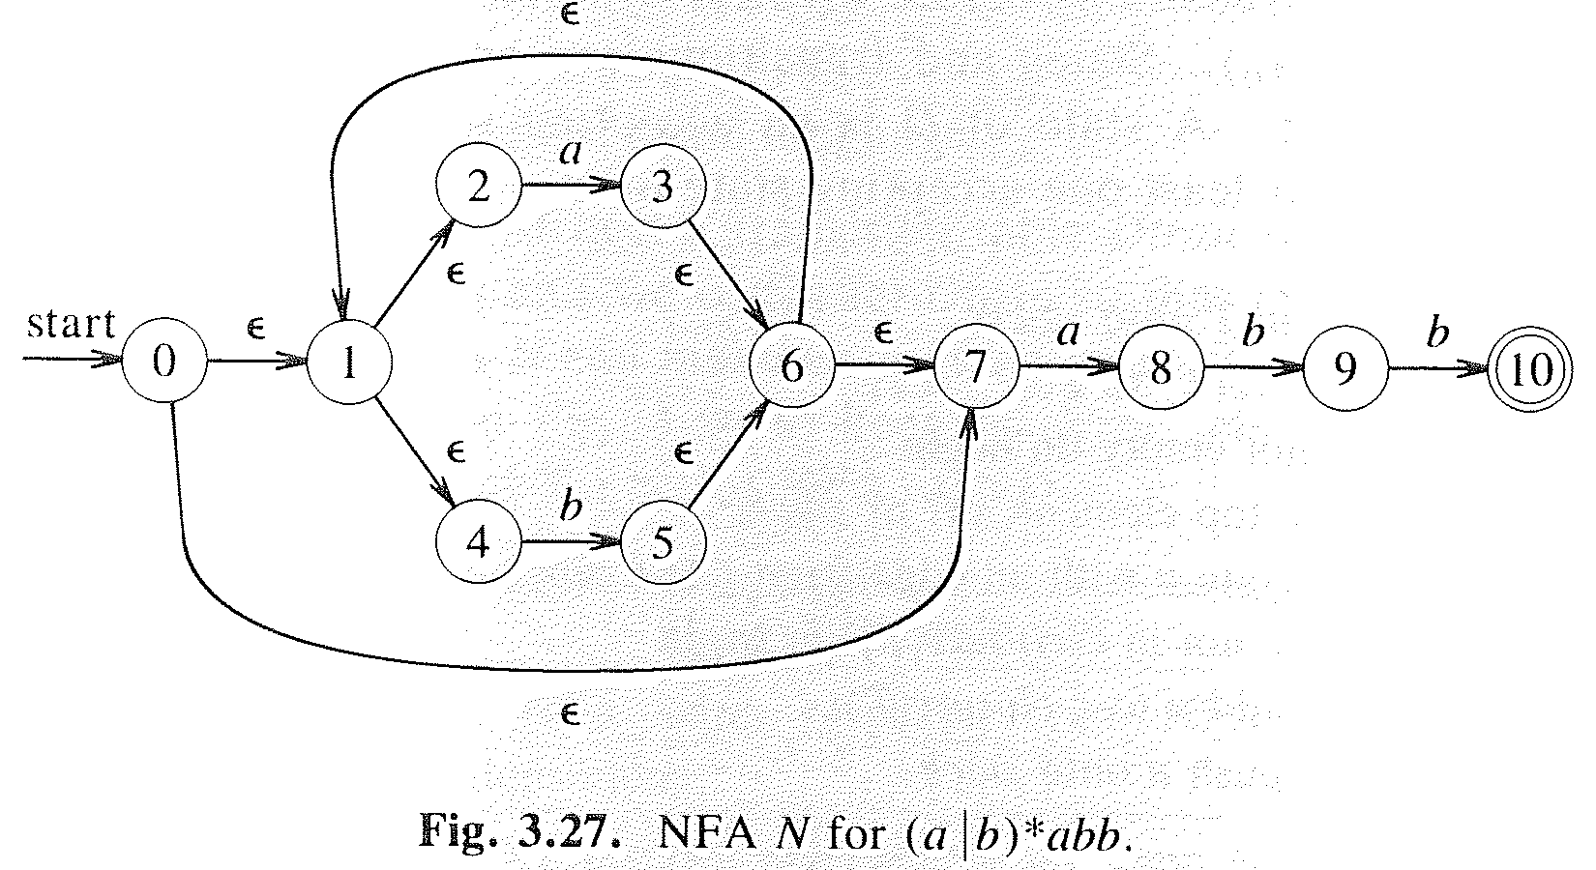
Example (III)
Winter 2007
SEG2101 Chapter 8

Slide 46
Conversion of an NFA into DFA
Subset construction algorithm is useful for simulating an NFA by a computer program.
In the transition table of an NFA, each entry is a set of states; in the transition table of a DFA, each entry is just a single state.
The general idea behind the NFA-to-DFA construction is that each DFA state corresponds to a set of NFA states.
The DFA uses its state to keep track of all possible states the NFA can be in after reading each input symbol.

Slide 47
Subset Construction
- constructing a DFA from an NFA
Input: An NFA N.
Output: A DFA D accepting the same language.
Method: We construct a transition table Dtran for D. Each DFA state is a set of NFA states and we construct Dtran so that D will simulate “in parallel” all possible moves N can make on a given input string.

Slide 48
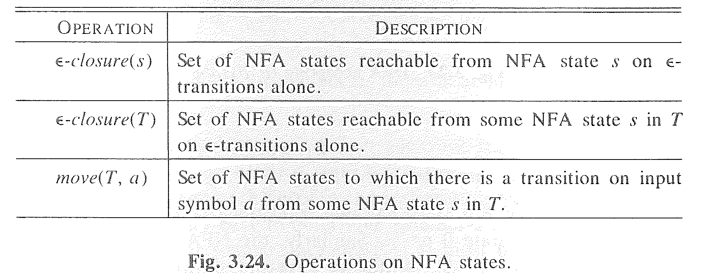
Subset Construction (II)
s represents an NFA state
T represents a set of NFA states.
Winter 2007
SEG2101 Chapter 8

Slide 49
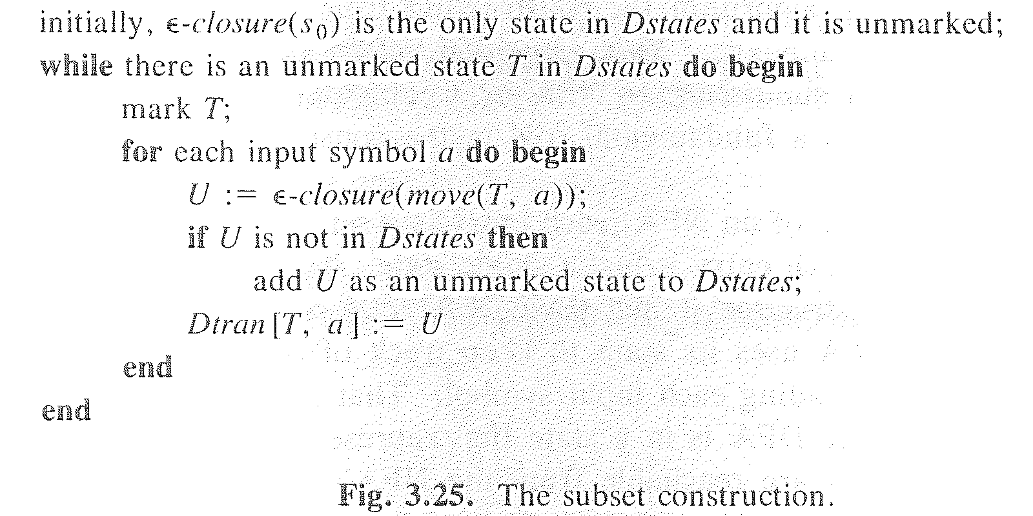
Subset Construction (III)
Winter 2007
SEG2101 Chapter 8

Slide 50
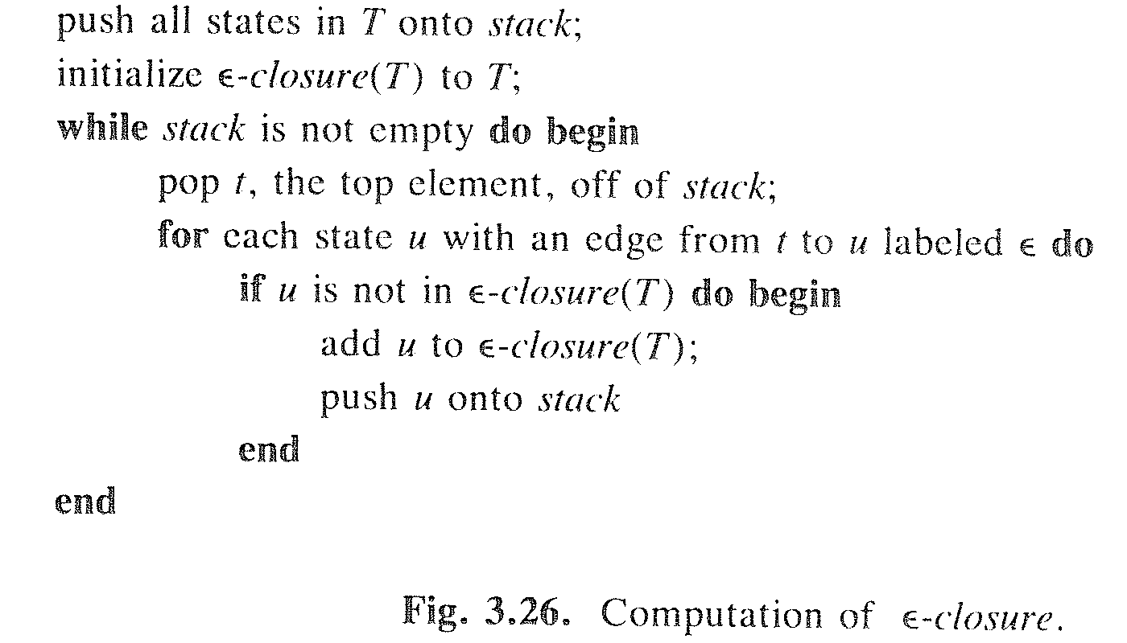
Subset Construction (IV)
(ε-closure computation)
Winter 2007
SEG2101 Chapter 8

Slide 51
Example

Slide 52
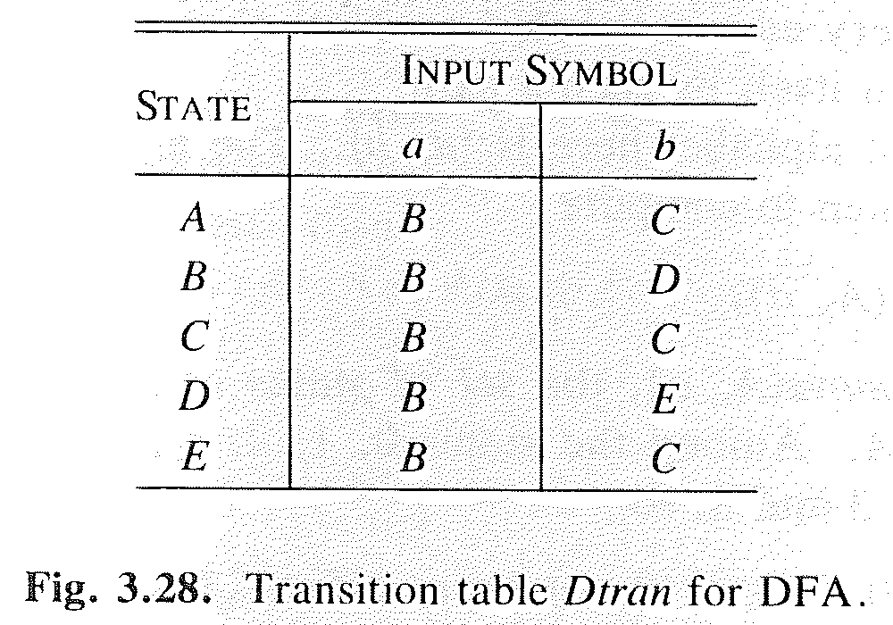
Example (II)

Slide 53
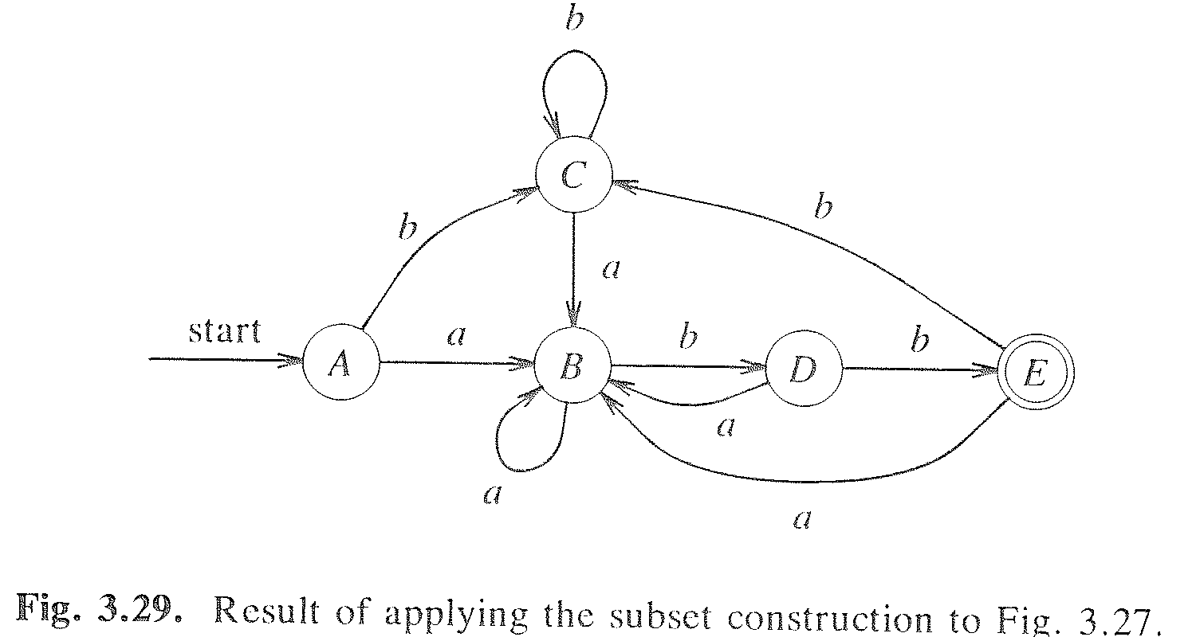
Example (III)

Slide 54
Minimizing the number of states in DFA
Minimize the number of states of a DFA by finding all groups of states that can be distinguished by some input string.
Each group of states that cannot be distinguished is then merged into a single state.

Slide 55
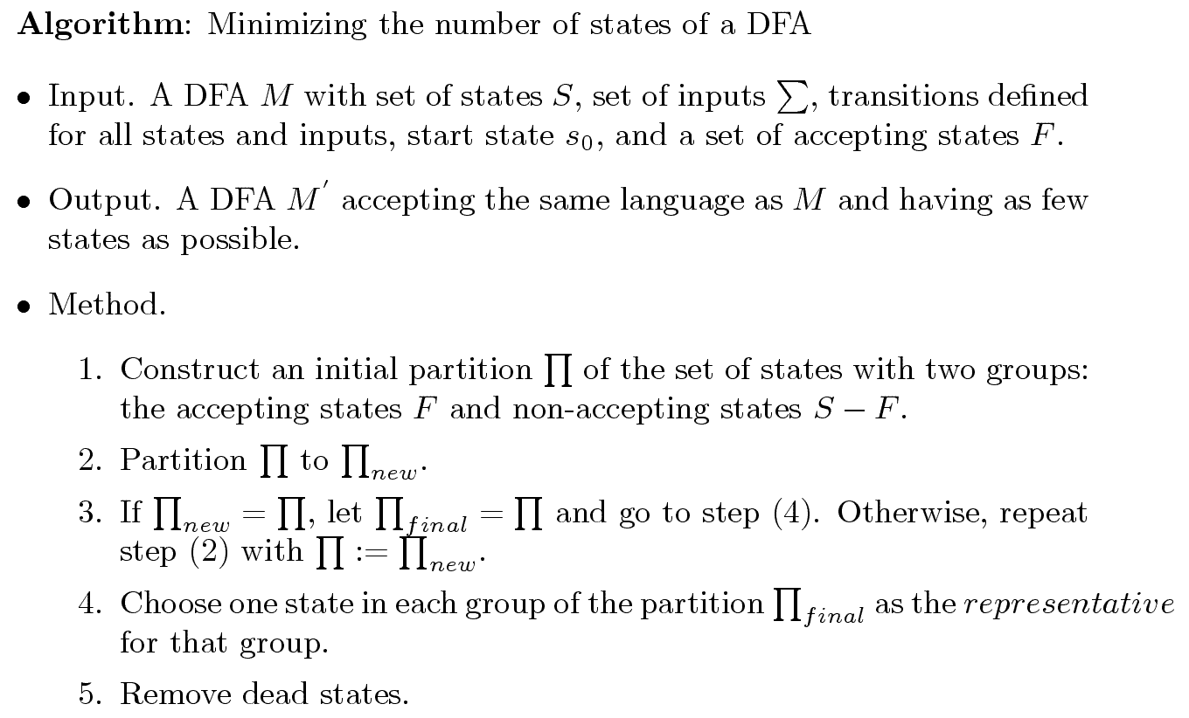
Minimizing the number of states in DFA (II)

